Slide 1
Lecture 11
Machine Learning 3
Notes:
Today we have the third lecture on Machine Learning. We start with a short recap.

Slide 2
Overview
1 Recap
2 Model Class Selection
2.1 Model Class Selection for Regression
2.2 Model Class Selection for Classification
2.3 Model Class Selection for Clustering

Slide 3
Part 1: Recap

Slide 4
Machine Learning Recipe
Choose the features
e.g. for text: word occurrence, average sentence length
Choose the model class
Choose a search method
Notes:
This is the basic machine learning recipe that was introduced last week. It starts with choosing features, or characteristics, of the data that will be used to make predictions about new data. Example features for text could include the occurrence of specific words in the document or the average sentence length. Today we will focus on the second step in this recipe, namely choosing the model class. Next week will focus on the last step, choosing a search method.

Slide 5
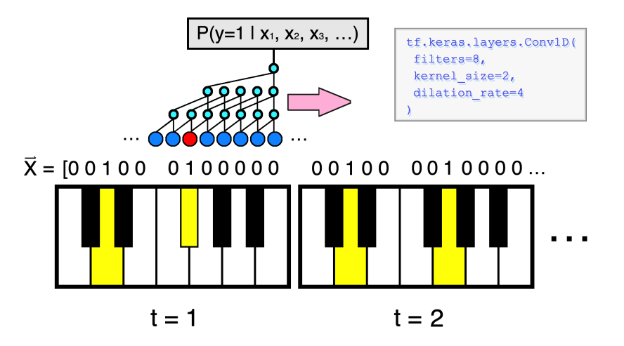
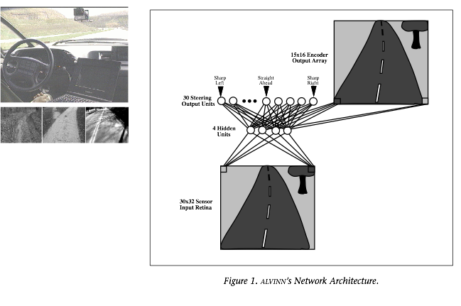
Features Revisited
tree age
tree height
label (class)
Features are characteristics of data that are generic; the way we think of features makes ML domain and problem independent.
3 | 105 | healthy
1 | 110 | healthy
8 | 120 | healthy
9 | 120 | healthy
11 | 124 | sick
7 | 127 | sick
7 | 130 | sick
8 | 130 | sick
9 | 132 | healthy
13 | 133 | sick
… | … | …
Notes:
To perform machine learning, we need to engineer certain features. This process allows us to translate generic AI problems into one specific representation on which we can apply several different AI models. For example, we can use the features age and height of a tree to predict their health. Each row in the table of features represents a single tree, or instance.
However, we can engineer these feature matrices for more complicated examples as well, for example the notes in a piano song, or the pixels of an image captured from a camera in a car while the driver turns the steering wheel. The latter example would enable the model to learn the association between a pattern of pixels and the direction in which the driver turns the steering wheel, so that the model can predict which way to turn the wheel for a new image. These matrices are the input for classifiers such as the Naive Bayes classifier we’ve seen already.

Slide 6
Part 2: Model Class Selection for Classification
Notes:
Let’s look at choosing the right model class for a classification problem to make the model more powerful.

Slide 7
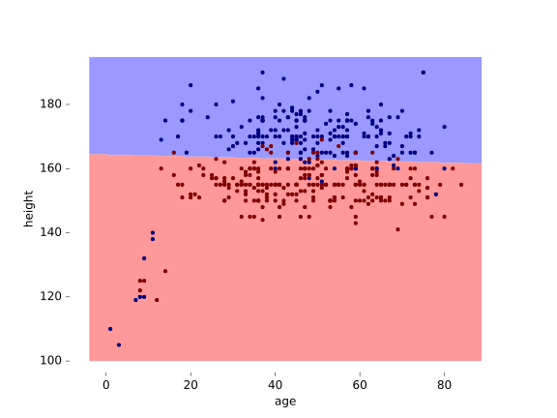
Classification
Recall our features
Option A: classify linearly (with a straight line)
tree age
tree height
label (class)
3 | 105 | healthy
1 | 110 | healthy
8 | 120 | healthy
9 | 120 | healthy
11 | 124 | sick
7 | 127 | sick
7 | 130 | sick
8 | 130 | sick
9 | 132 | healthy
13 | 133 | sick
… | … | …
Notes:
Recall our example of using tree age and height features to predict health of new data. On the left is the training data.
Here is a simple idea: draw a line, and call everything above the line healthy, and below it sick. We can draw many lines: the set of all possible lines we can draw is our model class. In the second half, we’ll see how to search the model class for a good model. For now, we just assume that we’ve chosen a reasonable line to classify our data. As you can see, quite a few examples end up misclassified, but most of them are on the correct side of the line. Our classifier would already to better than one that would simply guess at random.

Slide 8
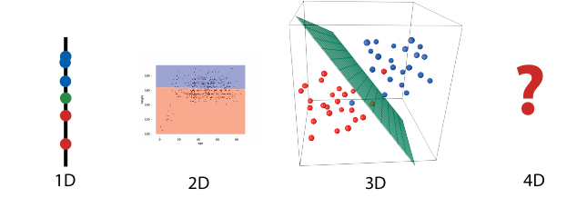
Model Class and Model Selection for Classification
Options B, C, D, … : define higher dimensions (= more columns in the table)
Instance x₁, x₂, x₃, x₄:
Healthy if ax₁ + bx₂ + cx₃ + dx₄ + e > 0
Sick if ax₁ + bx₂ + cx₃ + dx₄ + e < 0
Undecided if ax₁ + bx₂ + cx₃ + dx₄ + e = 0
We need to find the parameters a, b, c, d, e.
Notes:
Drawing a line to divide the data is only possible in two dimensions, i.e. when there are two features. What do we do if we have three features? Four?
In 1D, the equivalent classifier structure is a point. For example if we only have the feature height, any instance less than 170cm is female, any instance more than 170cm is male.
In 3D, we can cut the feature space in two with a plane.
In 4 or more dimensions, we can no longer draw it intuitively, but luckily the mathematics are very simple.
The classifier structure is called a hyperplane. Say we have four features, let’s call them x1, x2, x3, and x4. In four dimensions, every hyperplane is determined by five numbers, let’s say a, b, c, d, e. (in n dimensions, we require n+1 numbers).
We simply compute the expression above, and if the result is bigger than 0, we classify as healthy, and otherwise as sick. All we have to do now, is find the values for a, b, c, d and e that define a hyperplane that gives us the best classifications.
Incidentally, the value e is called the intercept. Without it, every hyperplane would cross the origin. The value e pushes the whole hyperplane up or down.

Slide 9
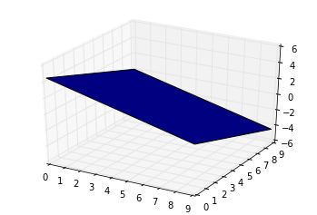
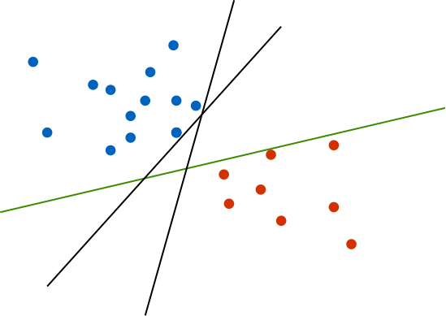
Defining the Hyperplane
The hyperplane is one dimension less than the dimensions of the feature space.
3 different hyperplanes with 100% accuracy.
Notes:
A simple way to understand a hyperplane is to look at the 3D graph on the left. The hyperplane that splits the space will be one dimension less, or a 2D structure. On the right we see that three different 1D hyperplanes in a 2D space all accurately split the feature space. Which hyperplane do we choose?

Slide 10
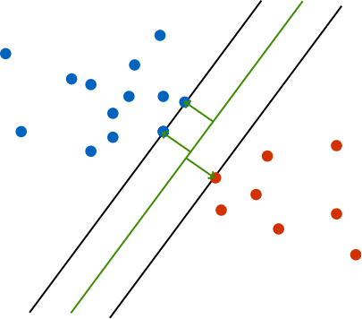
Maximum Margin Hyperplane
Choose the hyperplane with the maximum margin between it and the examples in each class.
Principle behind the very successful Support Vector Machines
Notes:
Here is a principle that tends to work very well. We choose the line for which the distances to the nearest example of either class is the greatest. In other words, the line with the maximum margin to all the data points.
The classifier that uses this principle is called the Support Vector Machine (SVM, invented in the 60s). However, I’ve not titled this slide “support vector machine”, because when people talk about SVMs these days, they’re actually talking about a specific use of the SVM, which we’ll come to later.

Slide 11
Not Linearly-Separable Data
x
y
Option: change the model class (e.g. ellipses, splines, circles)? This makes finding a good model very complex.
Notes:
Back to our dataset. The problem here is that our data is not linearly separable at all. How can we improve performance? It’s tempting to extend the model class, perhaps to include curved lines (circles, ellipses, splines, etc).
The problem is that such model classes makes the third step of our recipe (searching for a good model) a lot more difficult. Lines are easy to fit, so if at all possible we’d like to stick with straight lines.
So the only other option is to change the features. Of course we can go back to our tree instances and measure more characteristics (trunk diameter, leaf coverage, year of planting). But if we don’t have that luxury, we can change the features to help us learn a better model.

Slide 12
Design Matrix
Instead, we can change our features by creating new ones from existing features.
a | h | a² | ah | h² | class
3 | 105 | 9 | 315 | 11025 | healthy
7 | 119 | 49 | 833 | 14161 | healthy
8 | 120 | 64 | 960 | 14400 | healthy
9 | 120 | 81 | 1080 | 14400 | healthy
12 | 119 | 144 | 1428 | 14161 | sick
8 | 122 | 64 | 976 | 14884 | sick
8 | 125 | 64 | 1000 | 15625 | sick
aq + hr + a²s + aht + h²u + v > 0
design matrix
&
class (label) column
Notes:
This is a design matrix. We’ve taken the original features and added combinations of them as new features. Specifically, we’ve added all cross-terms: one feature multiplied by itself or another feature.
We now have a 5D dataset, to which we can fit a hyperplane.

Slide 13
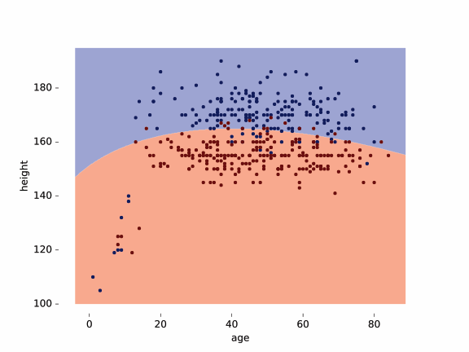
Higher Dimension Classifier Result
Projection of 5D classifier onto 2D feature space.
All datasets are linearly separable once projected into a space of high enough dimension.
Notes:
If we extend the judgements of this 5D classifier in the original 2D feature space, we get the following result.
Even though our classifier is linear (and thus still easy to fit), we get a curved line, getting a slightly better fit. The common wisdom is that all datasets are linearly separable if you project them into a space of high-enough dimension.

Slide 14
Higher Dimensions Example
y²
x
x
y
x²
y
FEATURES
x
y
x x² + y²
y
x² + y²
Notes:
Here’s an illustration of the power of adding features. On the left we have the original data with features x and y. The blue and red dots are not at all linearly separable. We need a model class that includes circular shapes in order separate these points properly.
Now, we add a third feature x² + y², which is the square of the distance of each point to the origin. The points now form a cone (middle figure) with the red and blue dots perfectly separable.
Of course, we can also add the cross product x² and y² as two separate features, as we did with the design matrix. If we discard the original feature we get the feature space shown on the right.

Slide 15
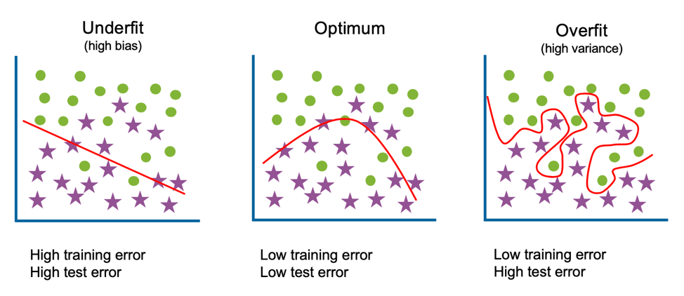
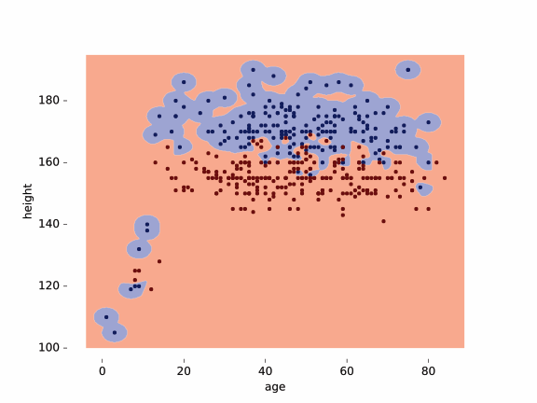
Under/Overfitting
Overfitting on our data.
Notes:
While the results of the classifier on the right looks very impressive, it’s too specific to this data and is called overfitting. The model has perfect performance on the training data, however, all it has done is to describe the exact shape of the training data. It doesn’t generalise. If we draw new data from the same source, we can imagine very well that we would get blue points in the red area. The opposite problem is called underfitting, meaning the classifier is too general and unspecific for the data.
In order to recognise that this we have actually learned a bad model, we need to withhold some training data to estimate the error, called the test data. You can make sure you don’t get into trouble at the end by estimating the error early on the validation data.

Slide 16


Evaluation of Over / Underfitting
training data
Check whether you’re overfitting by evaluating different model settings on the validation data.
Or use cross-validation when you have a small dataset.
validation data
test data

Slide 17
Part 3: Model Class Selection for Regression
Notes:
Let’s look specifically at model class selection for regression.

Slide 18
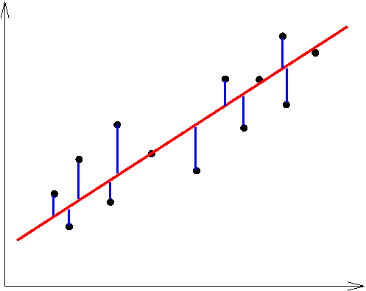
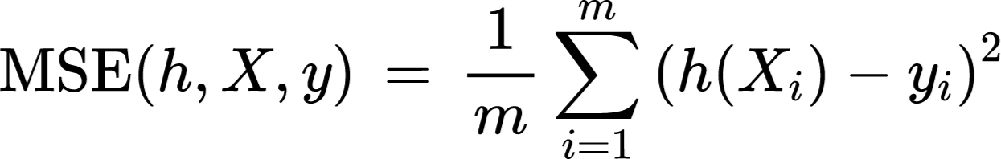
Let’s Start with an Example: Regression
Recall Mean Squared Error (MSE) function
h(x)
For each point, take its distance from the prediction, square, and take the average.
y
data point (x,y)
classifier line (x, f(x))
x
Notes:
Recall that regression is the task of predicting a numeric value for a certain instance, e.g. predicting the price of a house. Regression is evaluated in the same way as classification: withhold some data and use that to find how well the model does.
Of course, since we are predicting numbers, all predictions will be at least a little wrong, so we can’t just count how often the model got it right. Instead we sum how far each prediction was from the actual value in the target set in the Mean Squared Error function. We then sum the squares of these distances. We don’t sum the distances themselves, because they would cancel out (being both positive and negative).

Slide 19
Model Class Selection
Why do we choose to separate this data with a line?
Model class selection refers to choosing how to represent the data in the model.
What is the hypothesis?
Notes:
Model class selection asks how to best represent the data in the model. For the previous example, why should the data be separated with a line?

Slide 20
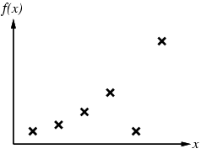
Model Selection for Regression
For a simple regression problem: construct hypothesis h so that it agrees with what is observed in the dataset f.
h is consistent if it agrees with f on all examples, e.g. curve f(x)
Notes:
In regression problems, the goal is to construct a hypothesis h, in this example a line, so that it agrees with our observed data f. We say that this hypothesis is consistent when it agrees with all of the data points.

Slide 21
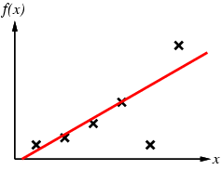
Model Selection for Regression
For a simple regression problem: construct hypothesis h so that it agrees with what is observed in the dataset f.
h is consistent if it agrees with f on all examples, e.g. curve f(x)
Notes:
This first line f(x) is a linear hypothesis.

Slide 22
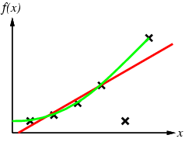
Model Selection for Regression
For a simple regression problem: construct hypothesis h so that it agrees with what is observed in the dataset f.
h is consistent if it agrees with f on all examples, e.g. curve f(x)
Notes:
But why choose a straight line when we could use this polynomial? The error rate is much better.

Slide 23
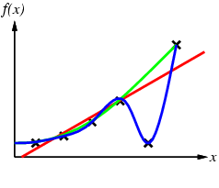
Model Selection for Regression
For a simple regression problem: construct hypothesis h so that it agrees with what is observed in the dataset f.
h is consistent if it agrees with f on all examples, e.g. curve f(x)
Notes:
We could improve the performance of our hypothesis even more with this blue line that is consistent.

Slide 24
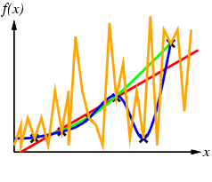
Model Selection for Regression
For a simple regression problem: construct hypothesis h so that it agrees with what is observed in the dataset f.
h is consistent if it agrees with f on all examples, e.g. curve f(x)
Notes:
In this same line of thinking, this orange line is also consistent. Why is this one less desirable than the other model classes? The problem is that this model class will not work well once new data is introduced. The idea is that the model class should be generalisable to new data.

Slide 25
Occam’s Razor
William of Occam was a 14th century monk.
Principle of parsimony:
“One should not increase, beyond what is necessary, the number of entities required to explain anything.”
When many solutions are available, choose the simplest one. What do we mean by simple?
We will use prior knowledge of a problem to define what is simple.
Notes:
Occam’s razor is a principle which roughly states that the best answer to a problem is the simplest one. This principle, also called the principle of parsimony, is commonly cited in computer science. Its relevance to machine learning is the lesson that a simpler solution will be better generalisable to new data than a complicated one. Think back to the blue and orange model classes in the last example, which are consistent for the observed data but won’t work for unseen data.

Slide 26
Part 2: Model selection for Linear Regression

Slide 27

Regression Review
Vivian | T | T | ?
MODEL
(regression)
LEARNER
< instance
9.5
feature
feature
label
Notes:
The table shows some data that we’ve been seen in a classification context, where the goal is to use the features to determine whether a student belongs to the passing or failing class. Now with regression, the label is a numerical value which we are trying to predict instead. Similarly to what we’ve seen, we still have a learner and a model, however the model performs regression instead of classification. The goal is to feed some data to the model that has learned from the training data, and the regression model will predict a grade.
Note that we could also model this as a multiclass classification problem, where every grade (5.5, 6, 6.5, etc.) is a class. The benefit of a regression model is that it can predict any real number between 0 and 10, e.g. 5.566.

Slide 28
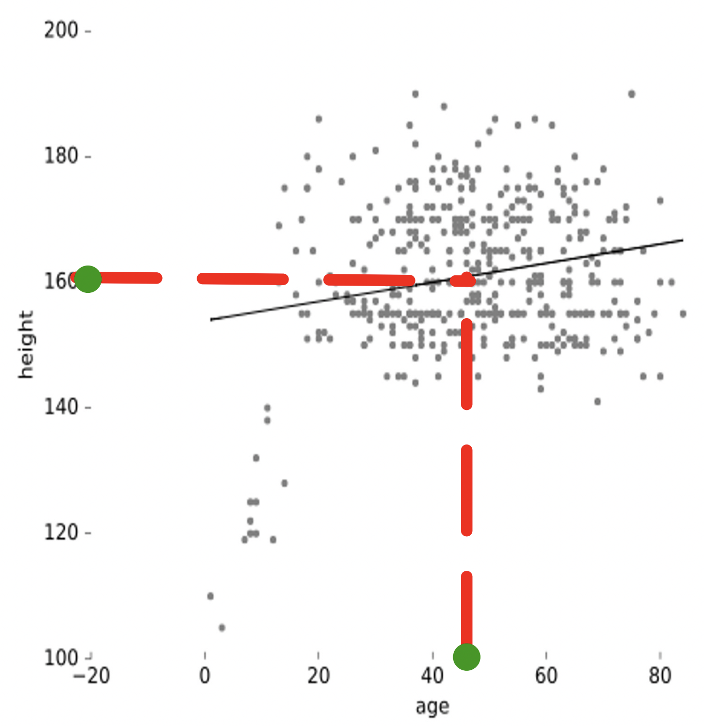
Finding the Best Regression Model: Example
Goal: predict height from age
# of features: 1
Simplest model: linear function mapping age to height
h(x_{i}) = sx_{i} + b
Notes:
Imagine that we want to predict the height of a person given their age. This means we have one input feature (age) and one label (height). We have a collection of training data - all the black points in the graph. The goal is for the model to guess the height of a person if only their age is known. The simplest function we can use is a linear model with the form y = mx+b, which looks like the straight black line in the graph.

Slide 29
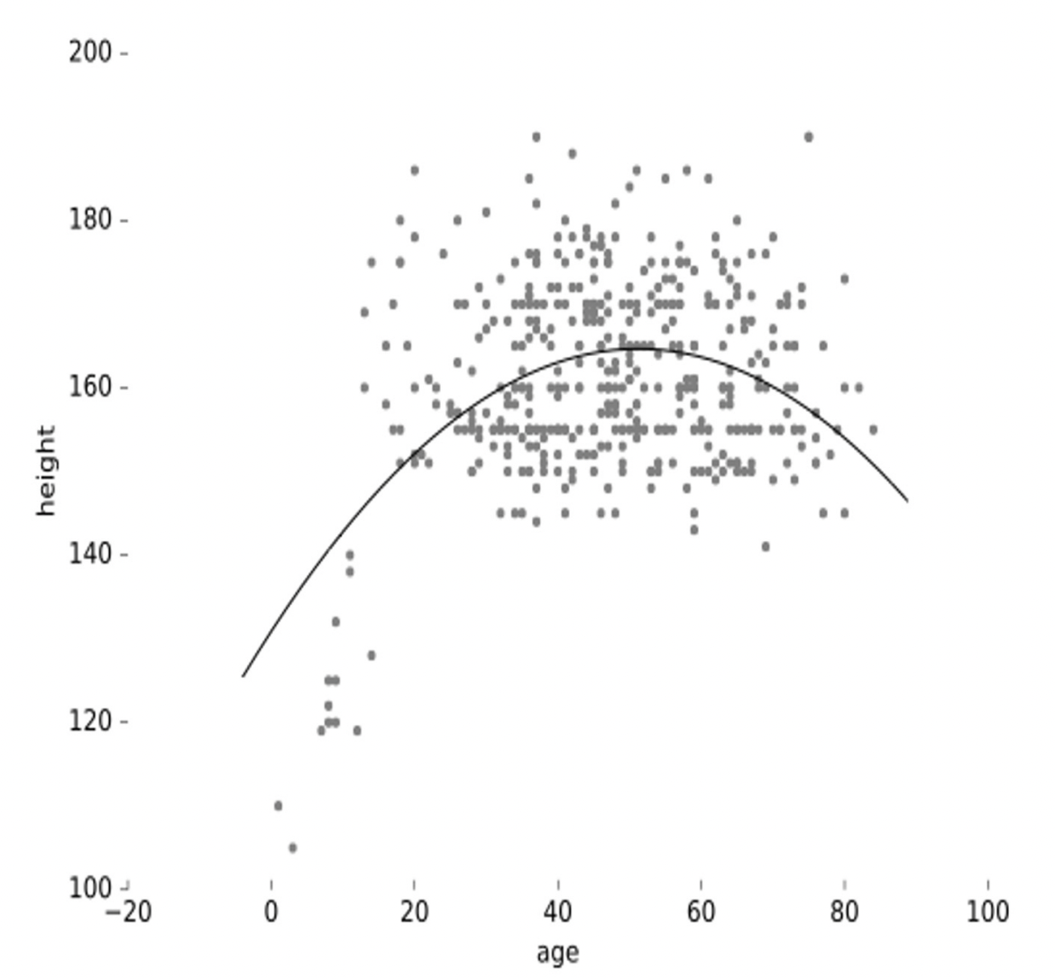
Recap: Adding features
A design matrix is a matrix of all the data, which can be used to add features by manipulating existing features.
Add age² for curved regression function
age | age² | height
15 | 225 | 163
7 | 49 | 100
30 | 900 | 180
25 | 625 | 176
13 | 169 | 145
11 | 121 | 122
design matrix X
&
target variable y
h(a_{i}) = sa_{i} + pa_{i}²+ b
Notes:
In some cases a linear function may be inadequate for modeling the data because it follows a different shape. When only using one feature, this isn’t possible. We can use a design matrix to create new features from existing ones in order to create other functions like a polynomial. We won’t be looking into these in this course but it is useful to know that this happens in practice. In this case, feature a is used to create a².

Slide 30
Part 2.1: Finding a Model
Notes:
How do we find a model or function that performs well in a regression task?

Slide 31
Mean Squared Error of Regression
Recall Mean Squared Error (MSE) function
h(x)
For each point, take its distance from the prediction, square, and take the average.
y
The best model is the one with the lowest error.
data point (x,y)
classifier line (x, f(x))
x
Notes:
To find the best model we can use an evaluation method like the mean squared error function to see which model performs best. The goal is to minimise the error as much as possible. MSE works by taking the distance between the line and each data point and squaring this, then summing over all the data points.

Slide 32
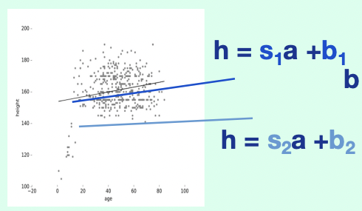
Finding the Best Model Example
b
s
feature space
model space
Notes:
This is an example with two different linear models, h=s₁a + b₁ and h = s₂a + b₂. To get a better idea of which model is best, we usually transfer from the feature into the model space with s and b on the axes. Each point in the model space is some kind of linear model with corresponding s and b parameters. Each point can be transferred back into the feature space to measure its error rate.

Slide 33
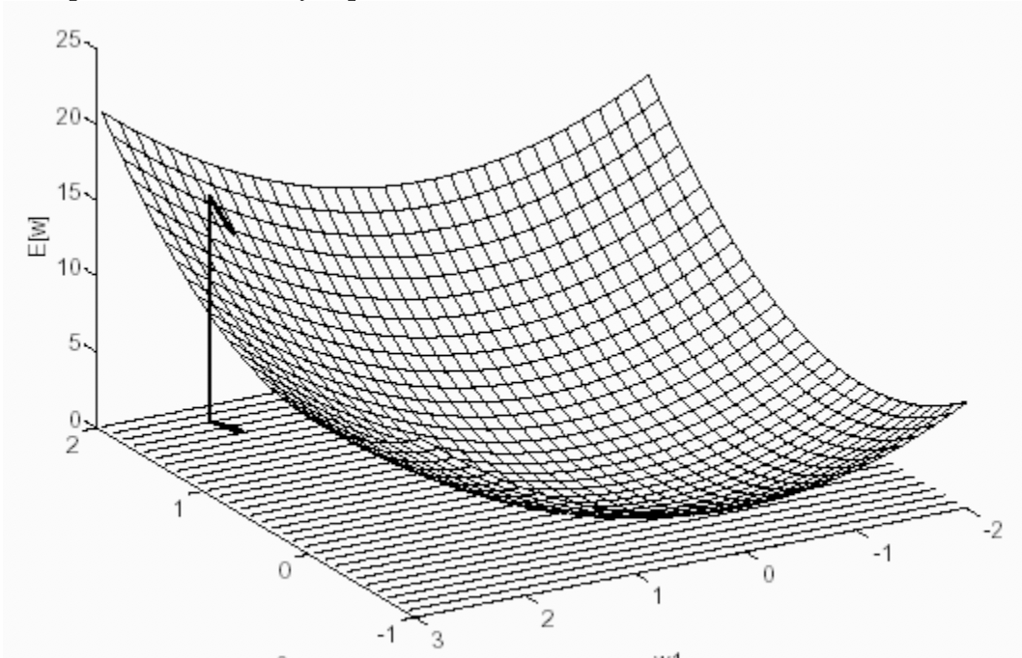
Error surface (for training set)
Model f(x_{i}) = sx_{i} + b
Error for instance i f(x_{i}) - y = sx_{i} + b - y_{i}
Squared error (sx_{i} + b - y_{i})²
Sum of squared errors error(s,b) = Σ_{i}(sx_{i} + b - y_{i})²
error surface
error(s,b)
s
b
model space
Notes:
In the diagram on the right we still have the model space with axes s and b. After computing the error rate of all possible models, we can combine these into the error surface as our third dimension. The greater the distance between a point in the model space and the error surface, the greater the error. The point on the model space which is closest to the error surface is the best model. In this example, it appears as though s=0 and b=0.5 is the optimal model. Keep in mind that in practice this is usually never visualised, especially because this is not possible for a much higher dimension space given more features.

Slide 34
Error surface (for training set)
Model f(x_{i}) = sx_{i} + b
Error for instance i f(x_{i}) - y = sx_{i} + b - y_{i}
Squared error (sx_{i} + b - y_{i})²
Sum of squared errors error(s,b) = Σ_{i}(sx_{i} + b - y_{i})²
error surface
error(s,b)
s
b
model space
Notes:
There are different techniques for finding the lowest point on the error surface. We will try to do this ourselves.

Slide 35
Finding a Model Practice
Find a model for the following data points.
(1,1), (2,1), (3,4)
Line through origin (0,0)
Notes:
Given a set of data points and a line, we can try to fit a model. Try to reason through a solution on your own first. Once the problem is graphed, how do we find the error?

Slide 36
Finding a Model Practice
Find a model for the following data points.
(1,1), (2,1), (3,4)
Line through origin (0,0)
Notes:
Once the points and line are graphed, we can take the distance between each point and the line and square it, giving us these boxes. We can sum these values together to find the error, and then search for the line that minimizes the sizes of these boxes. However, this is difficult and impractical on paper considering that we may have many data points. Let’s look at another method.

Slide 37
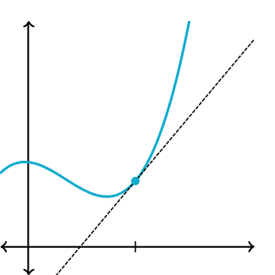
Tangent Line
Notes:
Recall from the calculus you may have had in high school that a tangent line (as shown in blue) can be found by computing the derivative of a function.

Slide 38
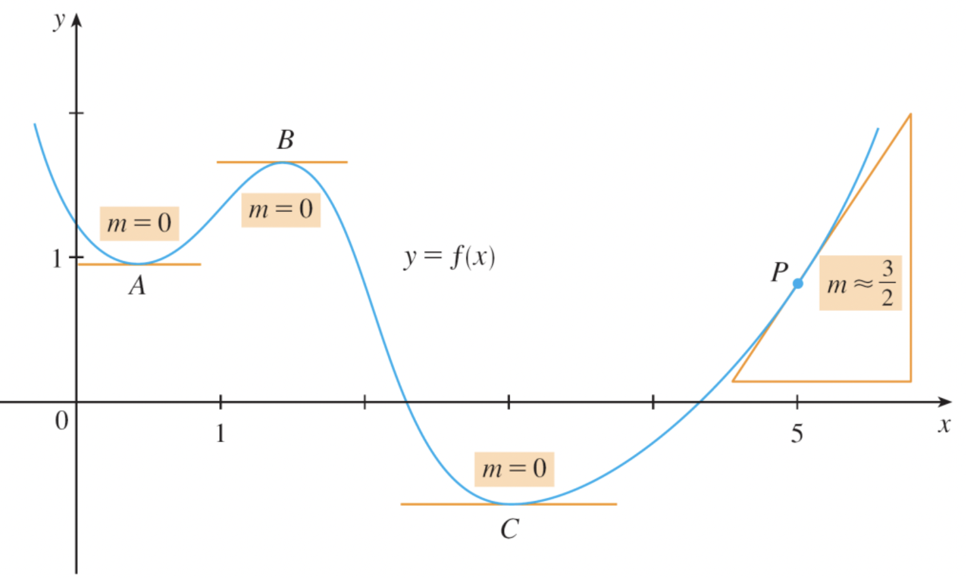
Properties of Optima
Notes:
You can think of this diagram as a 2D version of the model space and error surface diagram we saw on slides 12 and 13. An optimum is a point at which the derivative of a function is equal to 0, they look like the peaks in this graph. There are local optima and there are global optima. Local optima are points at which the derivative is 0, but it is not the lowest/highest point at which this occurs. Global optima are the minimums or maximums in a graph.

Slide 39
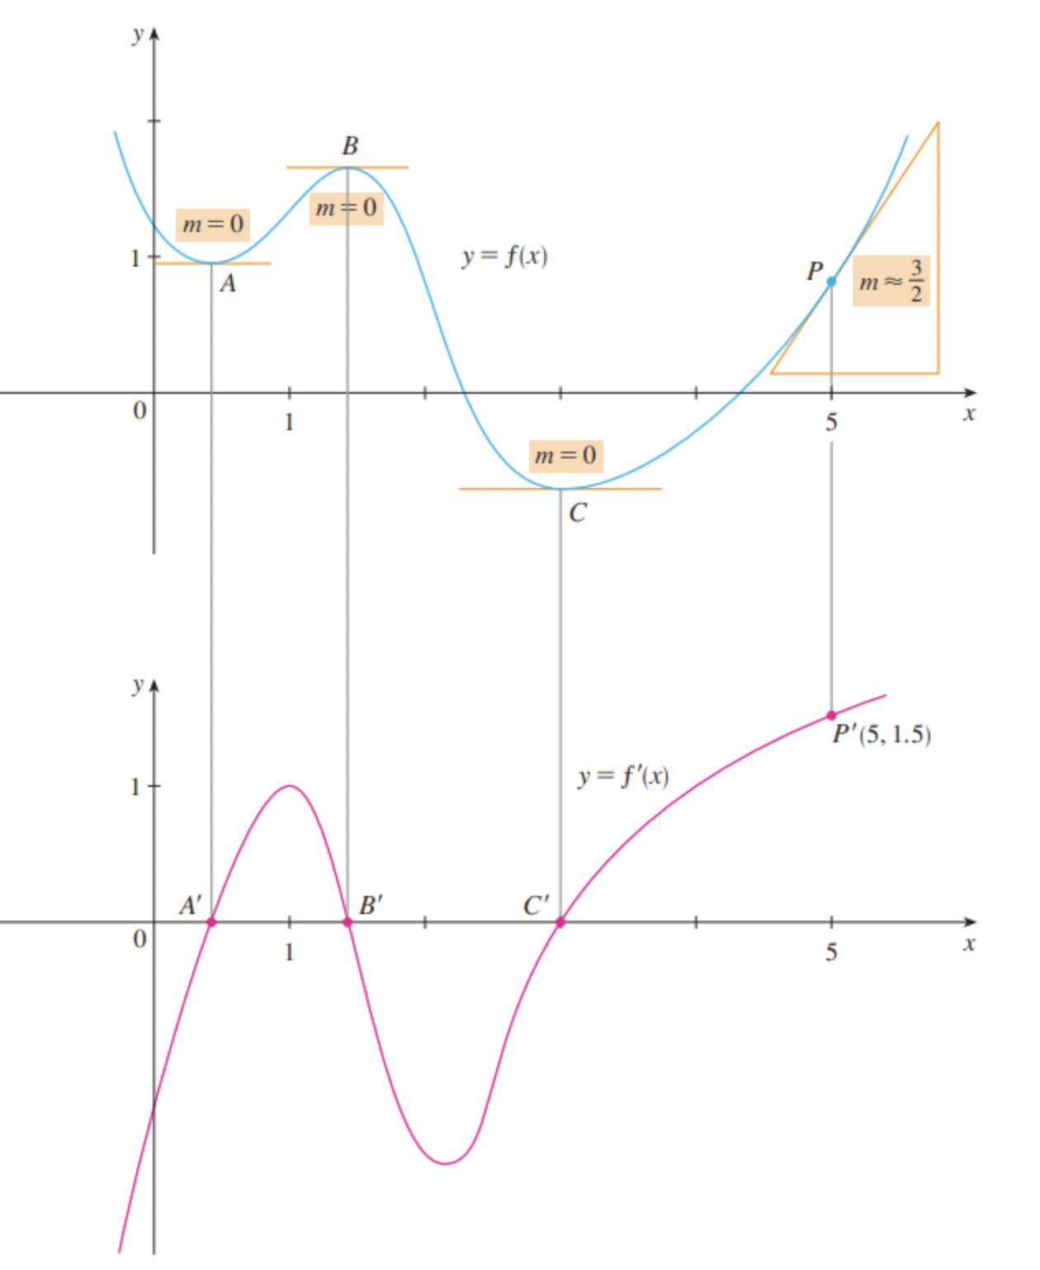
Properties of Optima
Notes:
We can also graph the derivative of a function, shown here in pink. Notice that every local or global optimum in the first graph is a point on the x-axis (y=0) in the graph of the derivative. This is useful because it means that we can find an optimum by setting the derivative equal to zero.

Slide 40
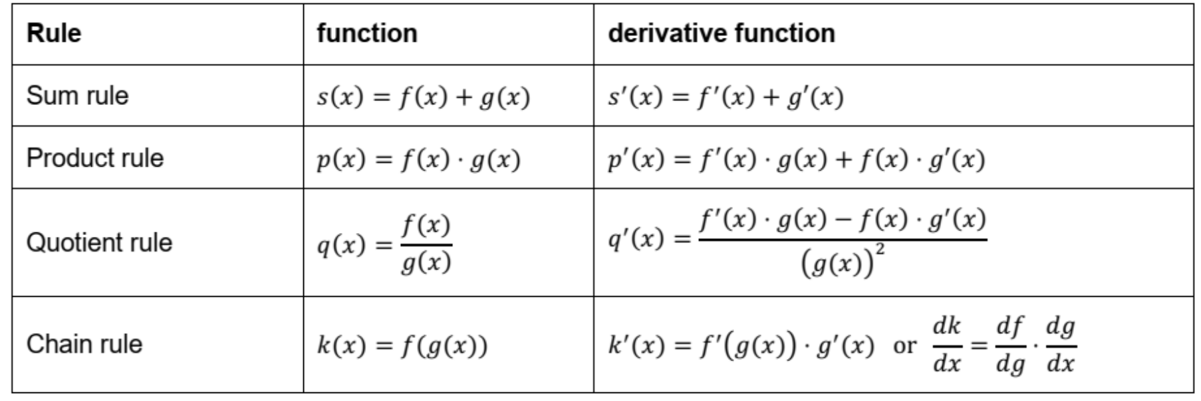
Differentiation Rules
Constant rule
Power rule
f(c) has f’(c) = 0 for a constant c f(x) = a⋅x^{n} has f’(x) = n⋅a⋅x^{n-1}
Notes:
These are the differentiation rules that you hopefully recall from high school. These are rules you should memorise and you will need to find the derivative of a function by hand. The derivative of a function is always denoted by an apostrophe, e.g. f’(x).

Slide 41
Differentiation Practice
f(x) = 6x³ - 3x + 45 f’(x) = ?
f(x) = (3 + 5x)² f’(x) = ?
Notes:
Let’s practice. The answers will be written below. These problems don’t require the more complex rules from the table.
f(x) = 6x³ - 3x + 45
Multiply the exponent by the coefficient in 6x³ and decrease the remaining exponent by 1. We do the same for 3x, but decreasing the exponent of x gets rid of it. 45 is a constant and is removed.
f’(x) = 18x² - 3
f(x) = (3 + 5x)²
Rewrite
f(x) = (3 + 5x)(3 - 5x) = 9 + 25x²
9 is a constant and is removed. For 25x², multiple the exponent by the coefficient and subtract 1 from the exponent.
f’(x) = 50x

Slide 42
Finding the Optimal Model
Model f(x_{i}) = sx_{i} + b
Error for instance i f(x_{i}) - y = sx_{i} + b - y_{i}
Squared error (sx_{i} + b - y_{i})²
Sum of squared errors error(s,b) = Σ_{i}(sx_{i} + b - y_{i})²
Model is optimal if error(s,b) is minimal, which is when error(x,b)’ = 0.
For n training examples:
((sx₁ + b - y₁)² + (sx₂ + b - y₂)² + … + (sx_{n} + b - y_{n})²)’ = 0
Notes:
The optimal model can be found by finding where the derivative is equal to 0. Essentially we’re solving the equation written at the bottom, which just means the derivative of the error function given only s and b, set to 0.

Slide 43
Find a Model Example
Data (x,y): (1,1), (2,3), (3,1) Model class: line through origin (0,0) → h(x_{i}) = sx_{i}
Find s where error’ = 0 → ((sx₁ - y₁)² + (sx₂ - y₂)² + … + (sx_{n} - y_{n})²)’ = 0
Calculate
(1s – 1)² + (2s - 3)² + (3s - 1)²
= (s² -2s +1) + (4s² – 12s + 9) + (9s² - 6s + 1)
= 14s² -20s + 11
Derive
error’ = 28s - 20
Set equal to 0 and solve
28s - 20 = 0
28s = 20
s = 0.71
f(x) = 0.71*x is optimal model
Notes:
Study this example well. Notice that, since the line starts at the origin, b = 0. If, for example, the y-intercept at 1, then b = 1.

Slide 44
Higher Dimensions
Tangent line → tangent hyperplane
Derivative → partial derivative (slope of tangent hyperplane in one direction)
Gradient → all partial derivatives
error surface
error(s,b)
Too complex to solve analytically!
s
b
model space
Notes:
What we just did is the 2D version of this diagram. In the model space we only calculated with the parameter s because b = 0. Finding the derivative was finding the error surface, and where the error surface is is the optimal model/global minimum/ lowest error rate.

Slide 45
Methods of Finding a Model
best case
Analytical solutions
Convex problems
Gradient descent
Uninformed Optimisation
worst case
Notes:
So far we have found the optimal case by solving it analytically. In practice these functions are too complex and it is not so easy to find the derivative. Gradient descent is commonly done in practice and we will look at this later in the lecture. In the worst case you could try uninformed optimisation, which means randomly jumping through the model space and calculating error rates.

Slide 46
Search via Gradient Descent
Gradient descent is an optimisation algorithm for finding the minimum of a differentiable function.
Pick random parameters s,b
Compute the gradient
Move a small step in the opposite direction
Repeat
error surface
error(s,b)
s
b
model space
Notes:
Gradient descent is an algorithm which performs the same function as we did analytically, however it starts by choosing two random values for s and b. Then the derivative for this point is calculated and a next point is picked by moving a small step in the opposite direction of the gradient (steepest descent). The idea is to eventually arrive at the minimum.

Slide 47
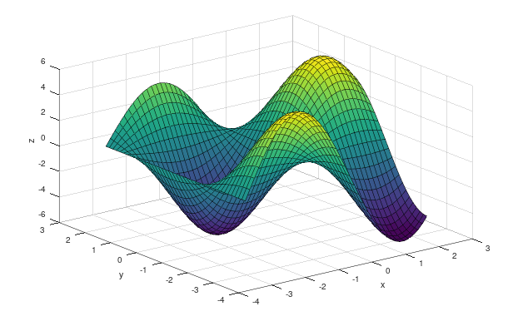
Gradient Descent Properties
No guarantee of convergence
Difficult to choose/control the learning rate
May get stuck in local minima
Powerful models
local minimum
global minimum
Notes:
Gradient descent may never converge, meaning a minimum is never found. It is also possible to end up stuck in a local minimum. This can happen because, once you are in a local minimum, moving a small step in any direction will always yield a worse result. Thus, the algorithm does not move to any other spot.

Slide 48
Stochastic Gradient Descent
Idea: only use one (random) sample or a subset of the training data to tune parameters
Properties:
More efficient, especially given a lot of training data
Faster
But: Can still get stuck in local minima
error surface
error(s,b)
s
b
model space
Notes:
Another version, stochastic gradient descent, undergoes the same process but only uses one sample or a subset of the training data. You do not need to know the details of how it works, but gradient descent is a common practice in AI and it is very useful to be at least familiar with the process.

Slide 49
Intelligent Systems Framework
Efficient, simple, correct, well-understood, generic | Find best decision based on experience. | Weeks 6 & 7
 | Find best decision with knowledge & reason. | Weeks 3, 4, 5
 | Find best decision in multiple agent setting. | Weeks 1 & 2
 | Find best decision with heuristics.
 | Systematically find all possible solutions.
Notes:
Progress in the intelligent systems framework.

Slide 50
Summary
Take Home Message
Different models are better equipped to deal with different dimensionality, like how many features we want to consider. Low dimensionality with high performance is the best case scenario.
Underfitting is when our classifier is too simple for the data. Overfitting happens when our classifier is too complex for the data (too tailored to the training data and not generalisable).
Features can be made from existing ones using a design matrix. The number of features changes which model is best. Regression models can be evaluated with mean squared error as a loss function.
We can find a model by setting the derivative of the function to 0. Gradient descent also finds model optima (local/global minima).

